Slide 1
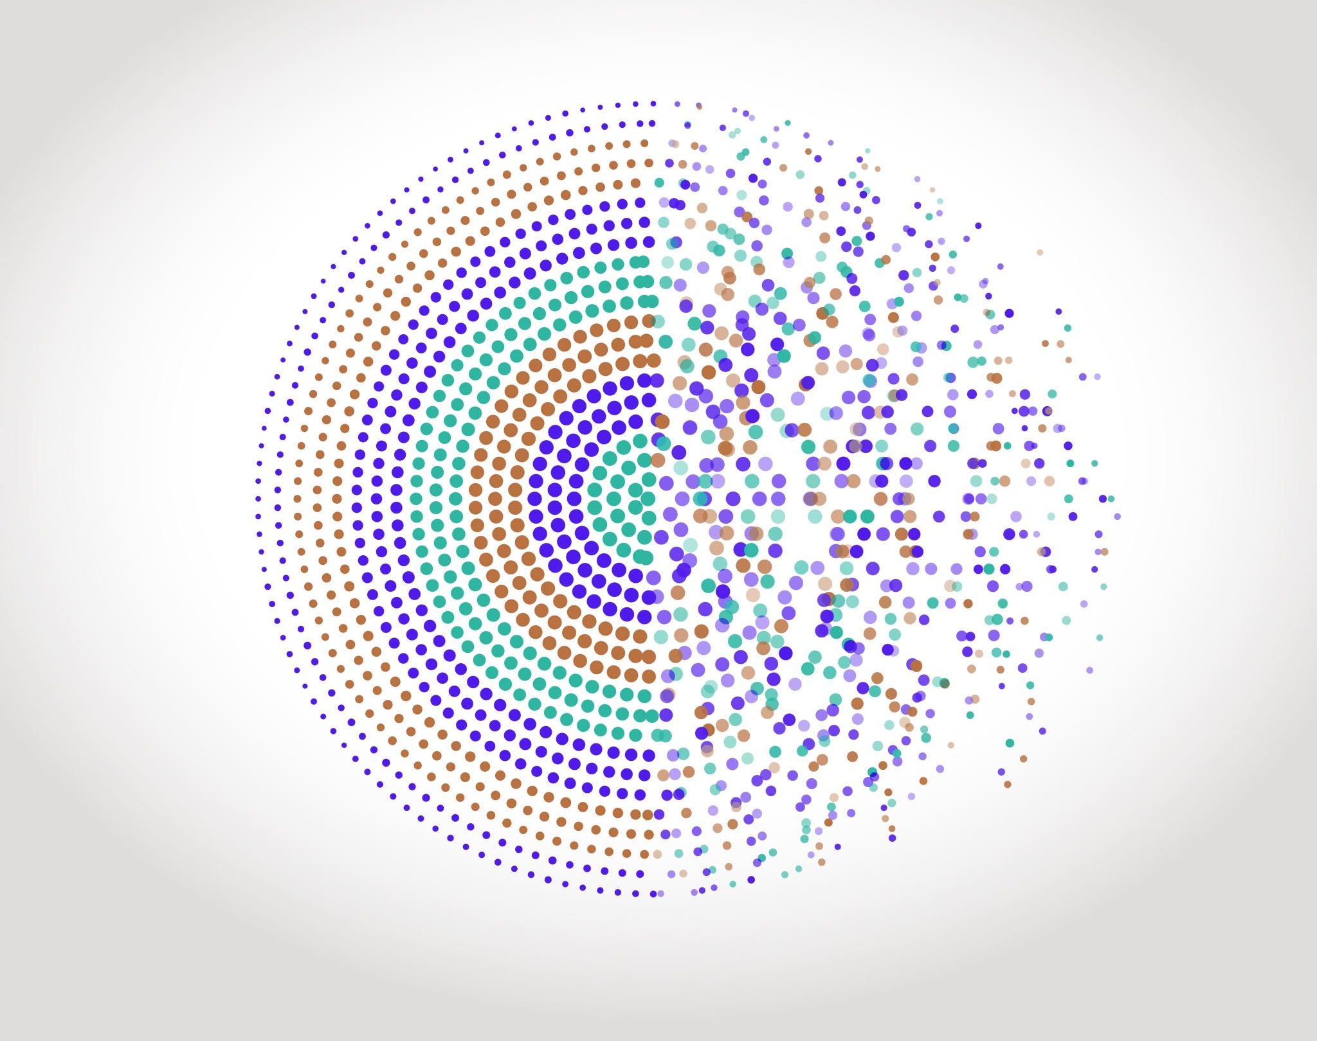

SC19 Cameras and Interfaces
Institut d’Optique
Formation Continue
Julien VILLEMEJANE

Slide 2
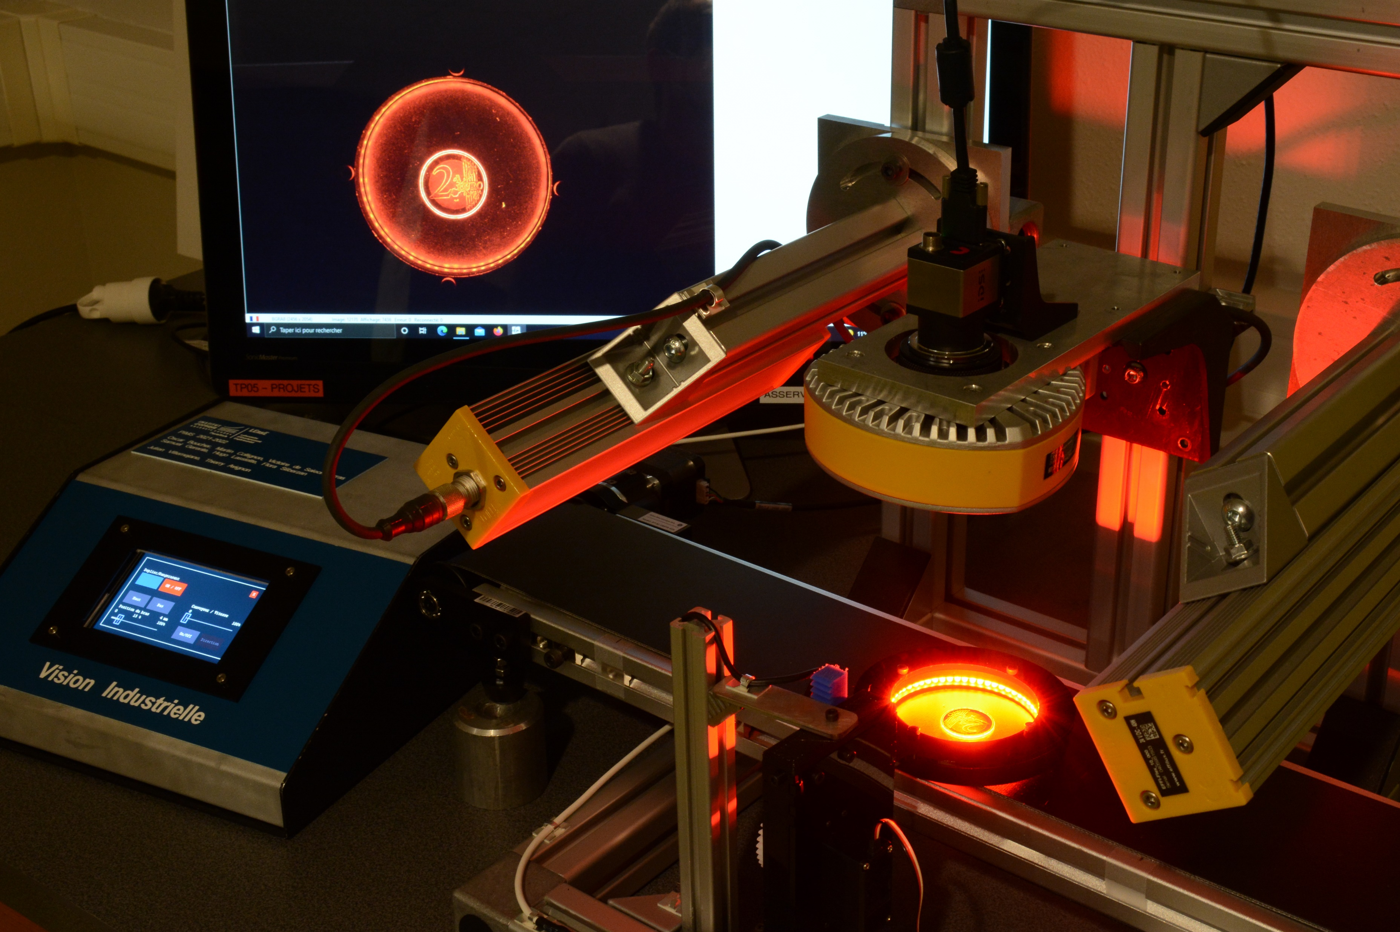

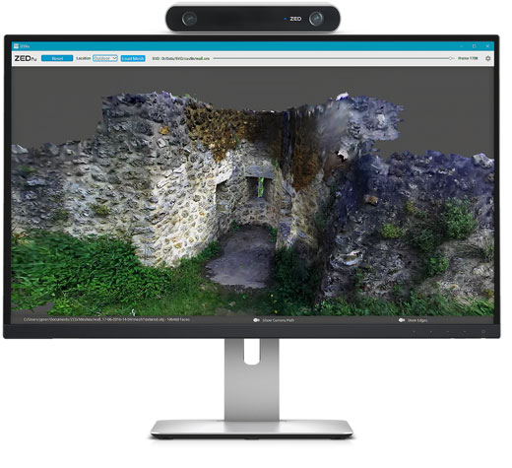
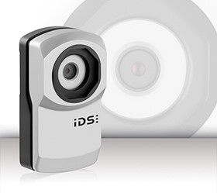
SC19 – Cameras and Interfaces
At the end of this training, the learners will be able to:
Characterize a camera and choose the interface
AOP
Sensor technology (2D, linear…)
CMOS Sensor characterization
(linearity, spatial homogeneity, noise…)
Protocols (Genicam, USB…)

Slide 3
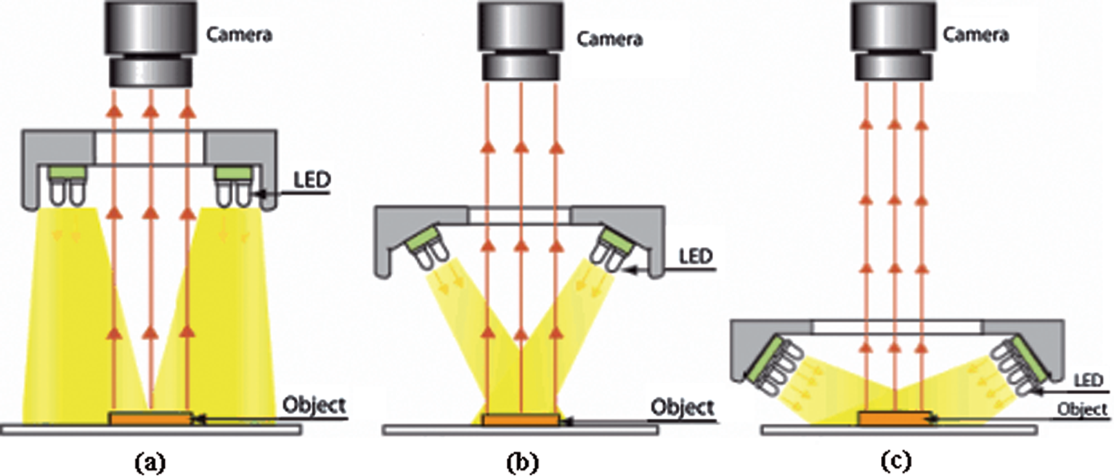
SC19 – Cameras and Interfaces
Camera in a machine vision system
Camera
Device that transforms a light flux into a measurable electrical signal
AOP
Electrical signal
Light flux
Camera
Dong, Jing-Tao & lu, rs & Shi, Yan-Qiong & Xia, Rui-Xue & Li, Qi & Xu, Yan. (2011). Optical design of color light-emitting diode ring light for machine vision inspection. Optical Engineering - OPT ENG. 50. 10.1117/1.3567053.

Slide 4
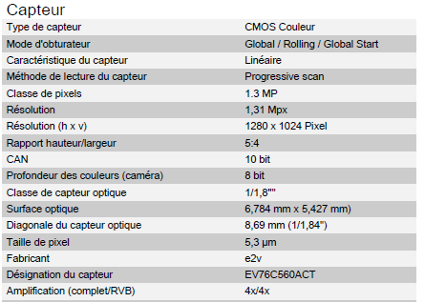
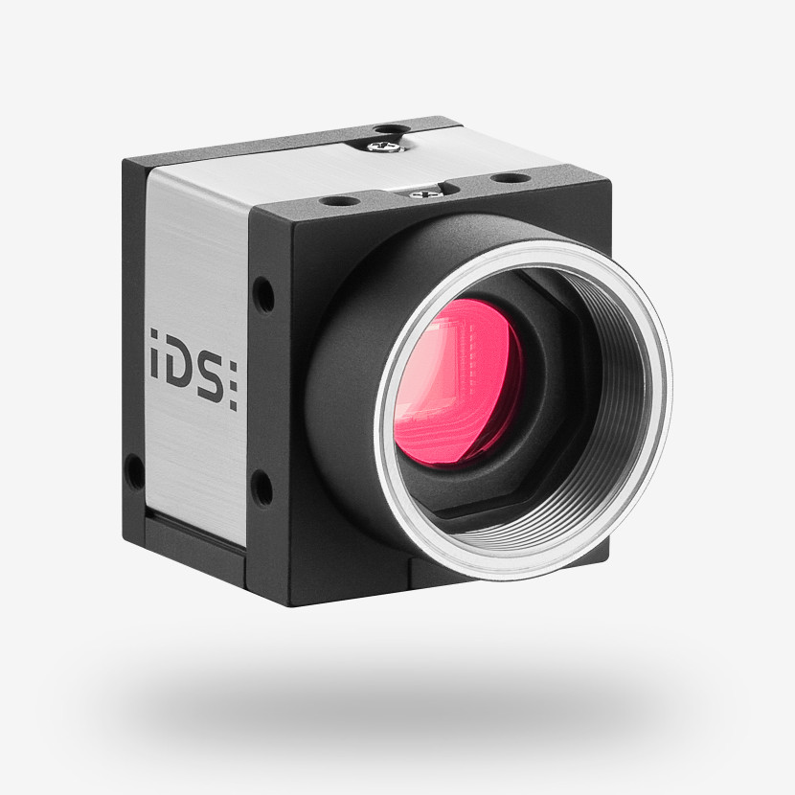
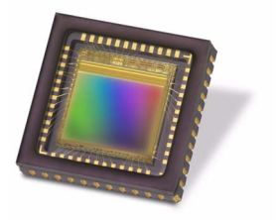
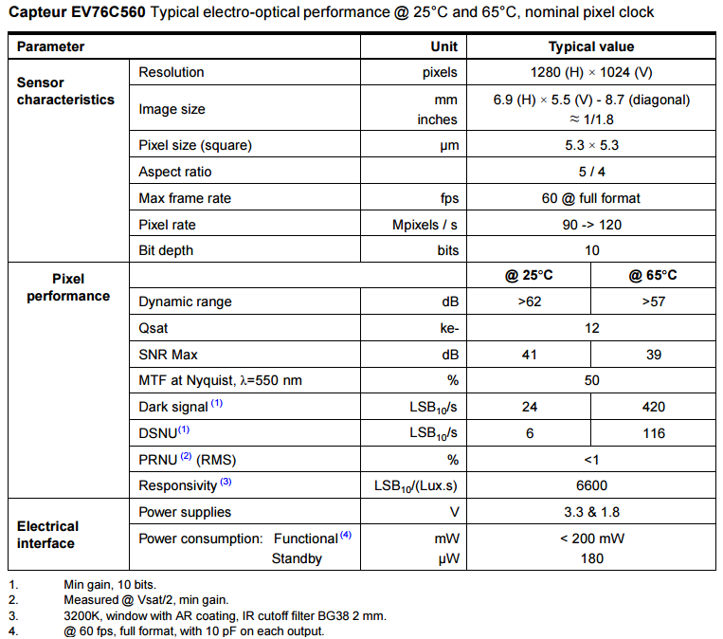
SC19 – Cameras and Interfaces
Camera : anatomy of an IDS sensor
e2v sensor EV76C560ACT
IDS UI-1240SE-C-HQ
Resolution
Sensibility
Noise Performance
Size / Form factor
Lens compatibility
Shutter Type
Interface

Slide 5
SC19 – Cameras and Interfaces
Main characteristics of the sensor
e2v sensor EV76C560ACT

Slide 6
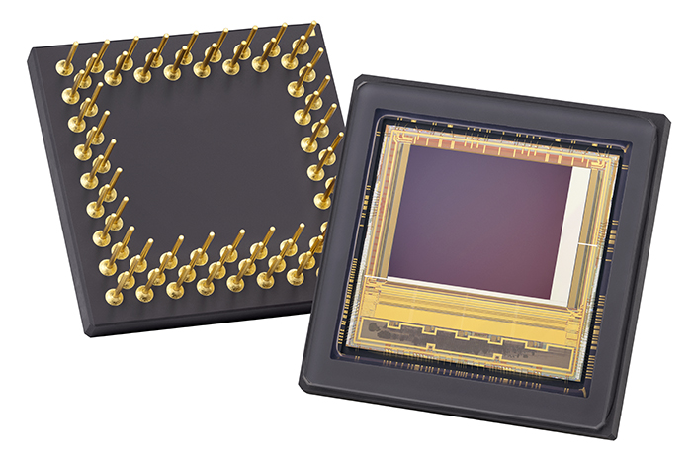
SC19 – Cameras and Interfaces
Camera : array of small sensors
Camera
Device that transforms a light flux into a measurable electrical signal
Columns
1
2
3
4
5
6
1
https://imaging.teledyne-e2v.com/products/2d-cmos-image-sensors/onyxmax/
Rows
2
Electrical signal
Light flux
Camera
3
4

Slide 7
SC19 – Cameras and Interfaces
Camera : array of small sensors
Columns
1
2
3
4
5
6
e2v sensor EV76C560ACT
1
Rows
2
Vertical number of pixels (v)
3
Resolution
Size / Form factor
4
Pixel size
Horizontal number of pixels (h)

Slide 8
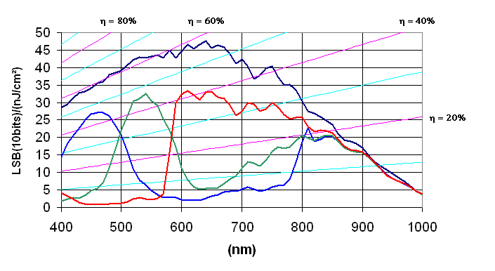
SC19 – Cameras and Interfaces
Camera : Bayer filter for color sensor
Columns
1
2
AOP
3
4
5
6
e2v sensor EV76C560ACT
1
Rows
2
3
4

Slide 9
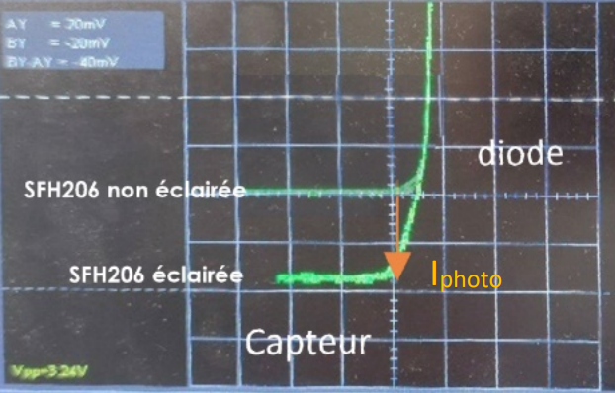
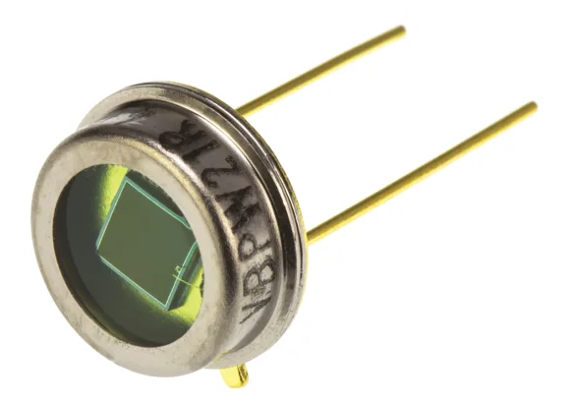
SC19 – Cameras and Interfaces
Inside a pixel
Columns
Camera
Rows
Device that transforms a light flux into a measurable electrical signal
Light flux
Current
Voltage
Sensor
Photodiode
Amplifier
Electrical signal
Light flux
Camera

Slide 10
SC19 – Cameras and Interfaces
From analog signal to digital data
Columns
Digital Camera
Rows
Device that transforms an array of light flux sensors into digital data called pixels
Light flux
Current
Voltage
Sensor
Photodiode
Amplifier
Light flux
Camera
Digital Data
Voltage
ADC
Digital Value

Slide 11
SC19 – Cameras and Interfaces
How an Analog to Digital Converter works ?
Example for n = 3 bits
Quantization
Voltage
ADC
Digital Value
Digital Value
b2 b1 b0
decimal
Digital Outputs
1 1 1
7
ADC
1 1 0
6
Analog Input
bn
1 0 1
5
n bits
1 0 0
4
b2
0 1 1
3
b1
b0
0 1 0
2
0 0 1
1
Each bit can have one of two values: 0 or 1.
0 0 0
quantum
0
The number of different values that can be represented by n bits is 2^{n}.
Vmin
Vmax
Analog input
voltage
Full Scale

Slide 12
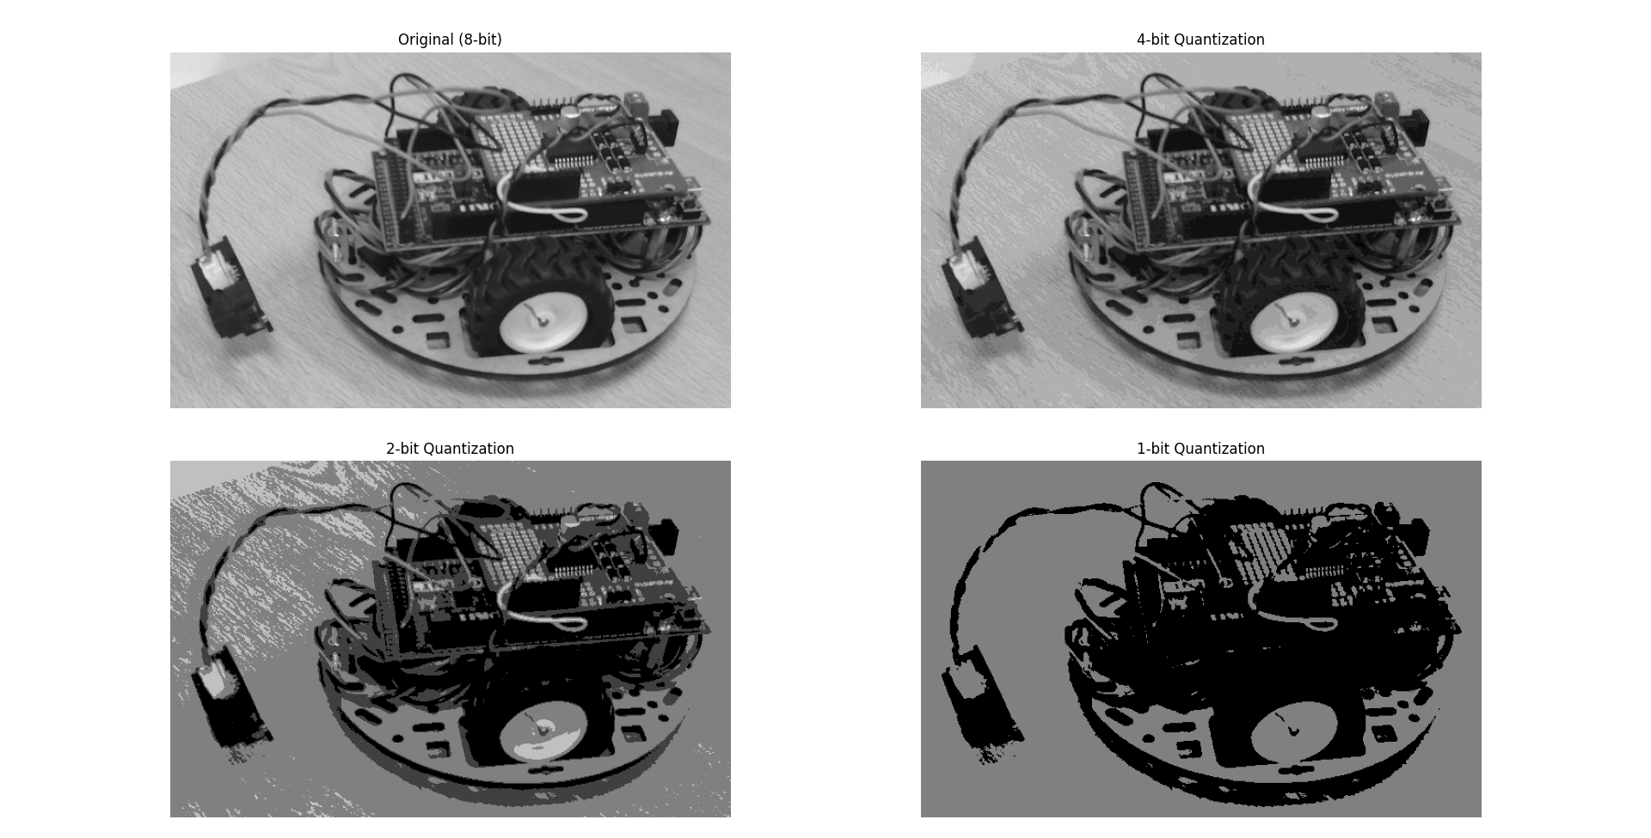
SC19 – Cameras and Interfaces
How an Analog to Digital Converter works ?
Quantization
Voltage
ADC
Digital Value
Digital Outputs
ADC
Analog Input
bn
n bits
b2
b1
b0
Each bit can have one of two values: 0 or 1.
The number of different values that can be represented by n bits is 2^{n}.

Slide 13
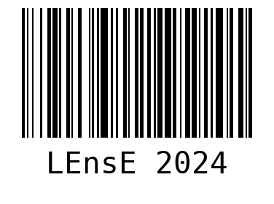
SC19 – Cameras and Interfaces
Sampling and quantification of an image
Sampling
https://barcode-coder.com/fr/specification-ean-13-102.html
Voltage
ADC
Digital Value
Barcode to decode
Area of sampling
Sampling theorem
Not so bad sampling rate
Nyquist–Shannon sampling theorem
The sampling frequency must be equal to or greater than twice the frequency associated with the finest detail in the image (edges).
With a grid spacing of d , a periodic component with a period higher than 2.d can be reconstructed.
Bad sampling rate

Slide 14
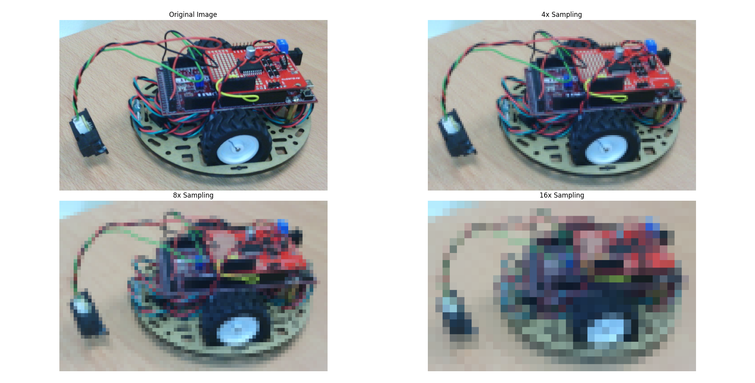
SC19 – Cameras and Interfaces
Sampling and quantification of an image
Sampling
Voltage
ADC
Digital Value

Slide 15
SC19 – Cameras and Interfaces
Camera : array of small sensors
The number of different values that can be represented by 10 bits is 2¹⁰ = 1024
In a Grayscale mode :
a black pixel is represented by 0
a white pixel is represented by 1023
Full scale of the ADC is 12 ke-

Slide 16
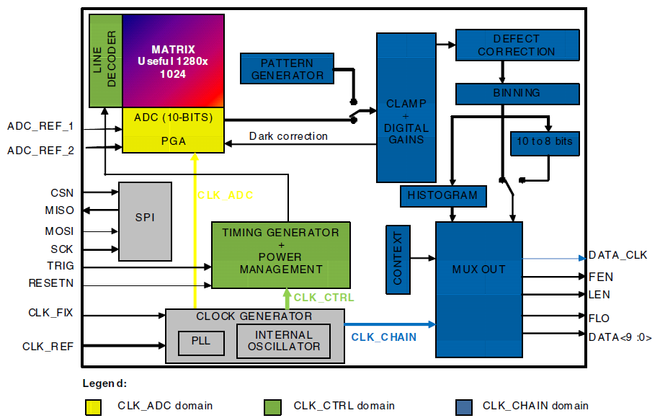
SC19 – Cameras and Interfaces
Inside a real camera
Columns
Rows
e2v sensor EV76C560ACT

Slide 17
SC19 – Cameras and Interfaces
Quantity of data per image
Columns
n bits
Nb of pixels = h x v
Rows
v
h
Each pixel is converted into n bits.
Each image has a total amount of binary data :
Nb of data (bits) = Nb of pixels x n

Slide 18
SC19 – Cameras and Interfaces
Quantity of data per image
Columns
n bits
Nb of pixels = h x v
Rows
v
Nb of pixels = 1280 x 1024
h
Each pixel is converted into n bits.
Each image has a total amount of binary data :
Nb of data (bits) = Nb of pixels x n
Nb of data (bits) = 1280 x 1024 x 10
= 13 107 200 bits

Slide 19
SC19 – Cameras and Interfaces
Frame rate
Each image has a total amount of binary data :
Frame rate
Nb of data (bits) = Nb of pixels x n
Number of individual frames captured per second by a device
Expressed in frames per second (fps)
Higher framerates result in smoother motion in video footage
The amount of data per second :
Nb of data per s (bits/s) = Nb of data (bits) x FPS
Example for a 4k camera in 12 bits @ 30 fps :
Nb of data (bits) = 3840 x 2160 x 12 = 99 532 800 bits
Nb of data per s (bits/s) = 99 532 800 x 30 = 2,9 billions of bits / s = 2,78 Gbit/s
In 2024, the transfer rate of a home router (optical fiber) is theoretically 8 Gbit/s (Free telecom - France)

Slide 20
SC19 – Cameras and Interfaces
Interface for data transfer
The data from a camera is transferred via an interface.
There are several types of standard interfaces.
 | USB 3.0 | 10 GigE | CameraLink | Coaxpress
Bandwith | 5 to 20 Gbit/s | 1.2 Gbits/s | Base : 2 Gbits/s Full : 5.4 Gbits/s (2 cables) | 12.5 Gbits/s per cable
Cable length | 3 m | 100 m | 7 to 15 m | 20 to 40 m
Power | 4.5 to 25 W | 30 W * | Optional | 13 W / cable
Frame Grabber | Not Required | Not Required | Required | Required
GeniCam | Required | Required | Optional | Required
AOP

Slide 21
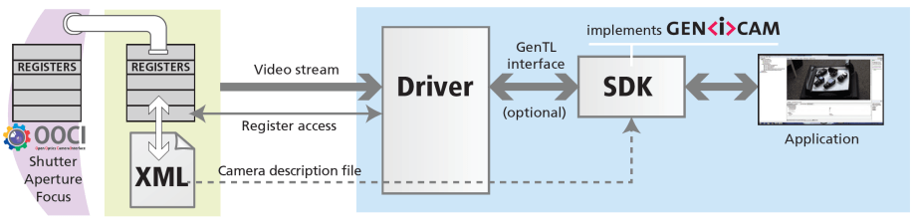
SC19 – Cameras and Interfaces
GeniCam ® : Generic Interface for Cameras
https://www.emva.org/standards-technology/genicam/introduction-new/
GeniCam® is a generic programming interface for all kinds of devices.
The application programming interface (API) will be identical regardless of interface technology.
AOP
GenApi defines the mechanism used to provide the generic API via a self-describing XML file in the device.
SFNC (Standard Features Naming Convention)
standardizes the name, type, meaning and use of device features
GenTL (Transport Layer) standardizes the transport layer programming interface (low-level API)
GenDC (Data Container) defines a portable Generic Data Container (GenDC) format
GenCP (Control Protocol) a low-level standard to define the packet format for device control

Slide 22
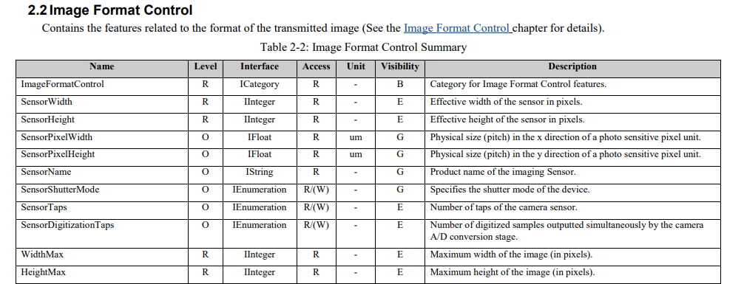
SC19 – Cameras and Interfaces
GeniCam ® : Generic Interface for Cameras
https://www.emva.org/standards-technology/genicam/introduction-new/
AOP
From the SFNC 2.7 (PDF)

Slide 23
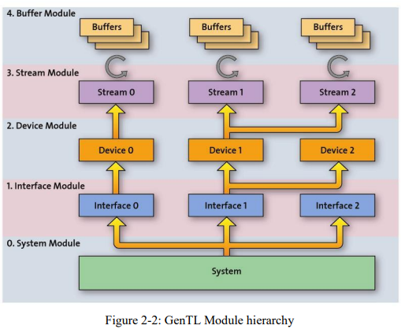
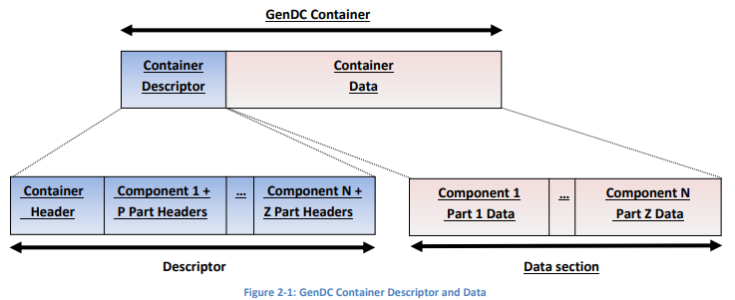
SC19 – Cameras and Interfaces
GeniCam ® : Generic Interface for Cameras
https://www.emva.org/standards-technology/genicam/introduction-new/
AOP
From the GenDC 1.1 (PDF)
From the GenTL 1.6 (PDF)

Slide 24
SC19 – Cameras and Interfaces
Dark current
Columns
Dark Current
Rows
Response of the sensor to complete darkness
Light flux
Current
Voltage
Sensor
Photodiode
Amplifier

Slide 25
SC19 – Cameras and Interfaces
Black level : an offset to compensate electronic defaults
Columns
Dark Current
Black Level
Rows
Response of the sensor to complete darkness
Change the overall brightness of an image.
Adjusting the camera's black level will result in an offset to the pixel's gray values output by the camera.
Light flux
Current
Voltage
Sensor
Photodiode
Amplifier
+
+
+ noise
+ manufacturing process, operating temperature,…
Black Level
Due to various physical and electronic factors, the sensor's output is never zero, even in the complete absence of light

Slide 26
SC19 – Cameras and Interfaces
Exposure time and linearity
Columns
Exposure Time
Rows
Duration for which the camera’s sensor is exposed to light, when capturing an image.
This parameter determines the amount of light collected.
Light flux
Current
Voltage
Sensor
Photodiode
Amplifier

Slide 27
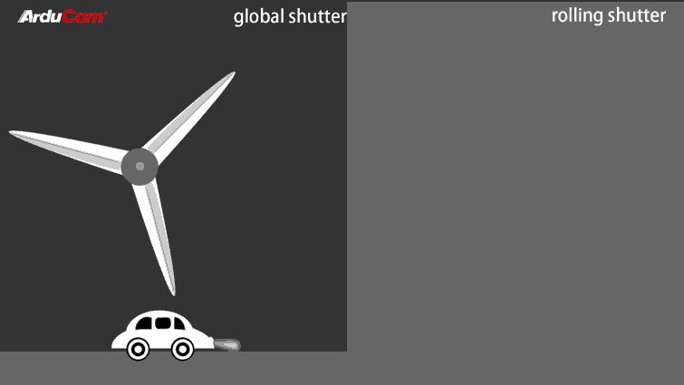
SC19 – Cameras and Interfaces
Shutter
Reset
Integrating
Readout
Global Shutter
Line 1
time
Line 2
Line k
Line N
Rolling Shutter
Line 1
time
Line 2
Line k
Line N

Slide 28



SC19 – Cameras and Interfaces
Spatial resolution
Small object to detect
Spatial resolution / P
d
Distance observed by a single pixel in a given direction
$$P=d$$
This security factor is due to the Nyquist-Shanon theorem.
And S >= 2
Security factor S
$$P=\frac{d}{S}$$
To verify is the spatial resolution is good enough, calibration target can be used. (Foucault)

Slide 29
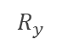
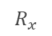
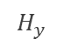
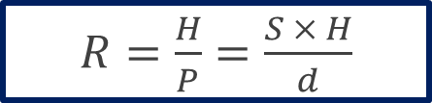
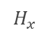
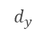
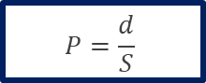
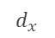
SC19 – Cameras and Interfaces
Resolution of the sensor
Spatial resolution / P
$$R_{y}$$
pixels
Distance observed by a single pixel in a given direction
Sensor
$$R_{x}$$
S
$$P=\frac{d}{S}$$
Sensor resolution (pixels)
$$d_{y}$$
$R=\frac{H}{P}$ $=\frac{S × H}{d}$
$$H_{x}$$
$$d_{x}$$
Inspection
Area
mm
H (mm) → R (px)
d (mm) → S (px)
P (mm) → 1 (px)
$$H_{y}$$

Slide 30
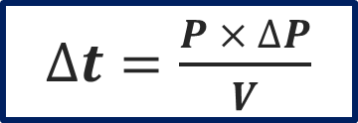
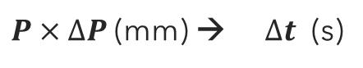

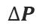
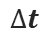
SC19 – Cameras and Interfaces
Motion, sharp image and maximum exposure time
Spatial resolution / P
V : motion speed (mm/s)
Distance observed by a single pixel in a given direction
$$P=\frac{d}{S}$$
$$∆t$$
time
V
Displacement
$$∆P$$
position
$P×∆P$(mm) → $∆t$ (s)
Motion blur perception threshold
to obtain a sharp image
is between
1/2 and 1/5 of a pixel
Time
$∆t=\frac{P × ∆P}{V}$

Slide 31
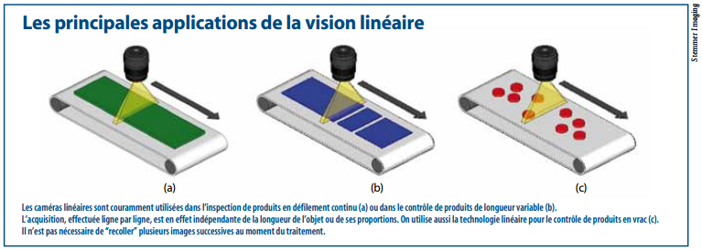
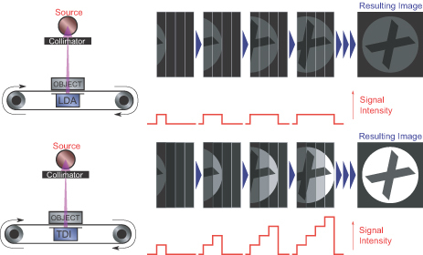
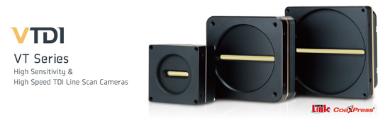
SC19 – Cameras and Interfaces
Linear camera
https://x-scanimaging.com/detectors/xti90802/

Slide 32
SC19 – Cameras and Interfaces
Bayer filter and image reconstruction
Interpolation
Columns
1
2
AOP
3
4
5
6
e2v sensor EV76C560ACT
1
Rows
2
3
4

